Slide 1
Architectural Elements Categorization
Smart Grid Architecture Committee (SGAC)
Architecture Development Team
Release 0.9

Slide 2
Proceed With Caution
The following material is offered as guidance for practitioners involved in Enterprise Architecture.
This is not a tutorial and the assumption is made that the reader has at least a basic understanding of enterprise architecture frameworks and semantic information concepts.
Background information on enterprise architecture and semantic frameworks, including TOGAF, Zachman, SOA, and OWL, is widely available and as near as a Google query.

Slide 3
Agenda
Background
Key Contributors
Problem Statements
Objective/Goal
Contributions
Data Reduction/Normalization Process
Architectural Element Categorization Guidance
Neutral Concepts Model Approach
Potential Future Phase
© 2000-2017 Smart Electric Power Alliance. All Rights Reserved. Page 3

Slide 4
Background
This effort advances smart grid / grid modernization architecture development efforts
Built upon earlier smart grid architecture efforts: NIST Framework and Roadmap for SG Interoperability Standards, SGAC smart grid architectural conceptualization and gathering of architectural elements, GWAC Interoperability Layers, and SGAM development and release
Using a methodology from common Architecture Frameworks: TOGAF, Zachman, and SOA
Copyright ©2017. SGIP, Inc. Page 4
© 2000-2017 Smart Electric Power Alliance. All Rights Reserved. Page 4
Notes:
NIST- National Institute of Standards and Technology
SGIP- Smart Grid Interoperability Panel
GWAC - Gridwise Architecture Council
SGAM – Smart Grid Architecture Model (European Union)
SOA- Service Oriented Architecture
TOGAF- The Open Group Architecture Framework

Slide 5
Key Contributors
Chair (2014-present): Dr. Elizabeth Sisley (Calm Sunrise Consulting)
Dr. Steven Ray (Carnegie Mellon University)
Ron Cunningham (AEP)
Dr. Gerald Gray (EPRI)
Stephan Amsbary (Emeritus Member)
John Ruiz (Emeritus Member/Chair)
© 2000-2017 Smart Electric Power Alliance. All Rights Reserved. Page 5
© 2000-2017 Smart Electric Power Alliance. All Rights Reserved. Page 1
Notes:
AEP – American Electric Power
EPRI- Electric Power Research Institute

Slide 6
Problem Statements
IT/OT Projects:
If fortunate, have access to prior/related projects’ artifacts to work from, but many times start from scratch when updating existing system or application architecture/designs
Deal with business, system, application, terms and definitions differently:
Assume that named terms/vocabularies used in industry or found in standards are interpreted the same across all users, groups, organizations, nations, or
Define their own Terms/Definitions without reuse of existing company or industry terms/definitions that are commonly accepted, or
Discover after the fact, what are in reality the same thing, are named differently across users, groups, organizations, nations, or
Project-defined context and abstraction levels of architectural terms and elements are not the same from one system-application project to the next, or
Struggle to gain understanding when integrating a project’s application(s), data, and messaging with another set of applications, data, and messaging,
End up identifying/naming/defining their own set of Actors, ServiceCompositions (~roles), Services used to document business scenarios, use cases, and stories
2016 Copyright © SGIP, Inc. CONFIDENTIAL. ALL RIGHTS RESERVED Page 6
© 2000-2017 Smart Electric Power Alliance. All Rights Reserved. Page 6
Notes:
IT - Information Technology
OT – Operations Technology

Slide 7
Objectives/Goals
Provide Guidance/Examples on how to align from one project’s set of architectural/business elements to another. Alternately encourage reuse of a reduced number of sets of architectural/business terms via understanding how a setA-element relates to a setB-element
Build up a common set of architectural/business elements and the relationships between them, that can be used, interpreted, understood, and modeled the same way across projects and organizations
Reduce the time/effort of each project’s re-identifying/re-naming/re-defining Actors, ServiceCompositions (~roles), Services, relationships, and associated missteps from one integration to the next
Help create a common vocabulary of terms and elements that is expected to make it easier to create new business use cases/stories that in turn are used to help identify the business requirements and services/capabilities that are used in project business scenarios and use case development, and advancing interoperability standards work
© 2000-2017 Smart Electric Power Alliance. All Rights Reserved. Page 7
© 2000-2017 Smart Electric Power Alliance. All Rights Reserved. Page 1

Slide 8
Contributions
Produced SGAC Architecture Element Metadata Model
Clarified architectural abstraction term definitions, categorized gathered use case architectural elements, developed a Decision Tree to classify:
Abstraction levels: Conceptual, Logical, Physical, Implementation
Architectural element types: Service, ServiceComposition, Actor
Leveraged architectural standards and business use cases for architectural elements from 18 organizations including, e.g., NIST, SGIP, NAESB, IEEE, IEC, and European Union (EU)
Used Web Ontology Language (OWL) and various architectural tools
Introduced “Neutral Concepts” multi-level model including the above metadata
© 2000-2017 Smart Electric Power Alliance. All Rights Reserved. Page 8
Notes:
NAESB- North American Energy Standards Board
IEEE- Institute of Electrical and Electronics Engineers
IEC- International Electrotechnical Commission

Slide 9

DATA REDUCTION/NORMALIZATION PROCESS

Slide 10
Data Summary
SGAC gathered a set of Use Case elements from 18 organizations and performed initial categorization of elements to Conceptual, Logical, Physical architecture abstraction levels. Combined set was also categorized as:
~ 180 Actors
~ 230 ServiceCompositions (~role)
~ 800 Services
Submitting Organizations
NIST (AMI Systems, Electric Transportation, Distribution Grid Mgmt, WASA, Demand Response, Electric Storage, Conceptual Model, and Reference Diagram)
NAESB
CSWG NISTIR 7628
IEEE P2030 Draft 3
EIS
EU Commission
EU WGSP Vers 0.5
SGAC Conceptual Arch
IEC TC57-WG19 & TC8 (SyC) WG6 DER Actor/Roles
EU SC-CG WP1
ENTSO-E role model
AhG Charging
IEC61968 IRM
IEC SG3
GUC
DKE Repository
SMCG
EG3
© 2000-2017 Smart Electric Power Alliance. All Rights Reserved. Page 10
© 2000-2017 Smart Electric Power Alliance. All Rights Reserved. Page 1

Slide 11
Data Reduction & Normalization Process
For each named Element, in TopBraid Composer’s (TBC) OWL model:
Where there were multiple submissions, definitions were reviewed to normalize entries
When definitions were either identical or very similar, or one had a missing definition – source data was consolidated, and all references kept for traceability
A few elements remain ambiguous, and will need to be reviewed by the submitting organizations for determination
These are flagged via a SeeAlso relation in TBC: listing one or more likely related elements
A few have no similar entries but are missing definitions, these remain uncategorized
Elements that are redundant or out of scope (such as ‘ActorA’ and ‘ActorB’) were marked as deprecated, but kept within the model
Elements were then categorized as described in the following slides
© 2000-2017 Smart Electric Power Alliance. All Rights Reserved. Page 11
© 2000-2017 Smart Electric Power Alliance. All Rights Reserved. Page 1

Slide 12
ARCHITECTURAL ELEMENT CATEGORIZATION GUIDANCE

Slide 13
Architectural Abstraction Level and Element Categorization Guidance
Architecture Abstraction Levels
Conceptual, Logical, Physical, Implementation
Service Oriented Architecture (SOA) Elements
Categorization of Elements into Actors, Services, and ServiceCompositions (~roles)
Categorization Guidance Decision Tree
© 2000-2017 Smart Electric Power Alliance. All Rights Reserved. Page 13

Slide 14
Framework Mapping
GWAC & SGAM Alignment with TOGAF
GWAC
Interoperability
Categories
(stack)
TOGAF/ADM*
Preliminary
(Context)
SGAM
Interoperability
Layers
A.
Architecture
Vision
8. Economic/Regulatory
H.
Change management
B.
Business
Architecture
7. Business Objectives
6. Business Procedures
Business
Requirements
Management
(Repository)
5. Business Context
G.
Governance
C.
Information
Architecture
Functional
4. Semantics
Implementation
Information
Communications
3. Syntactic Interoperability
F.
Migration
Planning
Components
D.
Technology
Architecture
2. Network Interoperability
E.
Implementation
Architecture
(Opportunities &
Solutions)
1. Basic Connectivity
Implementation
* The Open Group Architecture Framework – Architecture Development Methodology (TOGAF/ADM)
© 2000-2017 Smart Electric Power Alliance. All Rights Reserved. Page 14
© 2000-2017 Smart Electric Power Alliance. All Rights Reserved. Page 1
Notes:
GWAC – GridWise Architecture Council
SGAM – Smart Grid Architecture Model

Slide 15
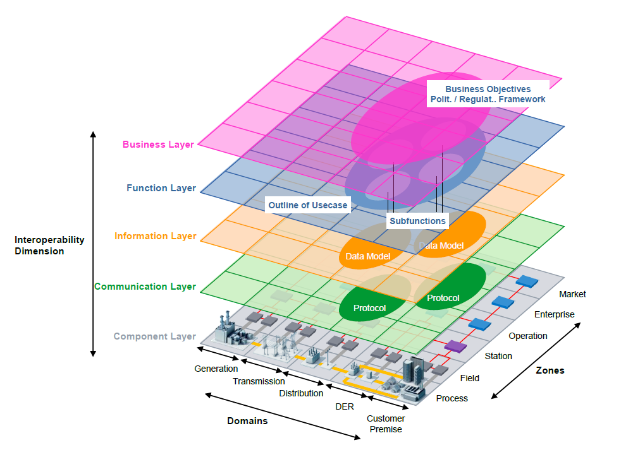
SGAM 5x5x6 Model
Figure 12: Layers of SGAM framework from SGCG Technical Report Reference Architecture for the Smart Grid v1.0 2012-03002
© 2000-2017 Smart Electric Power Alliance. All Rights Reserved. Page 15
© 2000-2017 Smart Electric Power Alliance. All Rights Reserved. Page 1

Slide 16
Architectural Abstraction Level mapping onto SGAM Interoperability Layers, with examples
Conceptual
Logical
Physical
Implementation
Services & Roles
Business Model
Department organization
Personnel & procedures
Business
Business procedures
Information flows
Workflow diagrams
Business Process tools
Function
Information
Abstract interactions
Interfaces
Semantic Models
Schemas, RDF
N/A
Communication flows
Syntax
Protocol Standard
Communication
N/A
Services
Applications& Devices
Product
Component
Work-in-progress
© 2000-2017 Smart Electric Power Alliance. All Rights Reserved. Page 16
© 2000-2017 Smart Electric Power Alliance. All Rights Reserved. Page 1

Slide 17
Architectural Abstraction Iterations within TOGAF
TOGAF/ADM
Preliminary
(Context)
Context
A.
Architecture
Vision
H.
Change management
B.
Business
Architecture
Conceptual
Logical
Physical
Requirements
Management
(Repository)
G.
Governance
C.
Information
Architecture
Implementation
F.
Migration
Planning
D.
Technology
Architecture
E.
Implementation
Architecture
(Opportunities
& Solutions)
Implementation
Implementation
© 2000-2017 Smart Electric Power Alliance. All Rights Reserved. Page 17
© 2000-2017 Smart Electric Power Alliance. All Rights Reserved. Page 1

Slide 18
Conceptual, Logical, Physical, Implementation applied to Zachman Levels
Note: TOGAF Phase C maps into Zachman Information and Automation
© 2000-2017 Smart Electric Power Alliance. All Rights Reserved. Page 18
Notes:
The 2 lower left orange shaded cells under Conceptual Level are to indicate that the Automation and Technical aspects are not applicatable at his high level of Architecture Abstraction (the ? Mark indicates still need to conform this with the Zachman International e.g.
Automation ask – What type of applications are required
Technical ask – What technology ICT (Information Computing Telecommunications) services are required.

Slide 19
Full Open Group SOA Ontology Mappings to SGAC Arch.Dev. Effort
© 2000-2017 Smart Electric Power Alliance. All Rights Reserved. Page 19
Notes:
Source of SOA metamodel – The Open Group “Service-Oriented Architecture Ontology Version 2.0” Figure 1: SOA Ontology – Graphic Overview
We choose Actor, Service, ServiceComposition, and Contract (not yet populated) for our modeling. Contracts is where the business contracts (Conceptual level) and non-functional (Logical and Physical levels) information will be represented.
Note:
Effect is not currently in the ADWP OWL model.
SOA element and thing are used in different context that SOA. SGAC uses element as in the phrase “architectural element” that includes e.g. Actors, Service, ServiceComposition, Contract. Thing is used in the SGAC Architecture Element Metadata Model as a general class, but not otherwise called out.

Slide 20
Conceptual Architecture Definition*
Conceptual Architecture models the business as the organization owner conceptually thinks the business is or wants the business to be. (e.g. black box view)
What are the services that are required to satisfy the business needs?
Business Services at the Conceptual abstraction level represent the goals of the owner
WHAT the organization wants to do, which is driven by its mission
WHAT it needs to do, which is often driven by regulations
Conceptual Services have a lot of attributes
Service levels and other non-functionals
Specifications of functionality
Simplest questions to identify Conceptual Elements:
WHAT are the essential elements within scope?
Which services are needed to provide to the outside world to fulfil its mission?
Which services from the outside world are needed to do that?
* Based upon Zachman Framework
© 2000-2017 Smart Electric Power Alliance. All Rights Reserved. Page 20
Notes:
Zachman Example of Conceptual, Logical, Physical Abstractions
The 'Owner': 'CONCEPTUALLY... I would like a pot of flowers in the center of my patio about 10 feet off the ground. They would be purely for ascetic reasons, but I want the pot to be BIG and the flowers to be real.‘
The 'Designer': 'Hmmmm. Let me see now... the physics of this situation would suggest that there are two LOGICAL alternatives... either 1) you would have to have a pedestal about 10 feet high, the weight it would have to sustain is max of 100 pounds so if it was 10 square inches in area (cross-section) the material would have to hold 10 lbs per sq. inch. You're second alternative 2) would be to hang it from something above the pot... do you have a roof over the patio?? If not, that would mean we would have to construct a tripod to suspend the pot from the apex. Do you care if you see the tripod? Hmmmm. I recommend you go with the pedestal.‘
The 'Builder:' 'Hmmmm... the Architect is suggesting a pedestal that would be 10 feet high and sustain 10 pounds per square inch. That Architect wouldn't recognize a lathe if he fell on one... but here's what we could do... we could PHYSICALLY build the thing in three pieces and then glue it together with superglue... just in case, we could make flanges on the pieces so we could bolt the pieces together to make sure they don't come apart. Your other alternative is to have it made in Japan and ship it in one piece and then we could install it by drilling a hole in the patio, sinking the base down 2 feet and filling in the hole with cement.
Reference: http://www.zachman.com/ea-articles-reference/58-conceptual-logical-physical-it-is-simple-by-john-a-zachman

Slide 21
Logical Architecture Definition
Logical Architecture models the technology-agnostic “systems” and representations of the business that are used to realize the services defined at the conceptual level. This includes business functions and actors. (e.g. white box view)
How are the business functions and actors ideally structured?
HOW are basic elements related, according to the specific objectives and constraints of the architecture? (Logical Structure)
What are the building blocks needed to run the business as defined in the Conceptual Architecture?
Building blocks are technology independent services
This is more about the interfaces than the technologies
2016 Copyright © SGIP, Inc. CONFIDENTIAL. ALL RIGHTS RESERVED Page 21
© 2000-2017 Smart Electric Power Alliance. All Rights Reserved. Page 21
Notes:
Technology specific details are included in the Physical abstraction level.

Slide 22
Physical Architecture Definition
Physical Architecture further constrains the Logical architecture. This is the abstraction level where application and system architecture/design/technology choices are made that address and may constrain the business, application, and data model. This level represents HOW the Architecture ideally is being designed, excluding further Implementation level restrictions.
Addresses what actors, software and processes are necessary
HOW elements of structure will be realized, according to architecture and design strategies and implications, and with WHAT will this be achieved?
Describes physical implementation components. This set of components is a representation of components or building blocks an architect will use:
A person
A process
A piece of software
A piece of infrastructure
Provides technical implementation specifications; the details needed for white box development processes (eg: ITIL, Rational Unified Process, Software Development Life Cycle, Agile), vendor solutions, and manual processes (TOGAF Phase E).
2016 Copyright © SGIP, Inc. CONFIDENTIAL. ALL RIGHTS RESERVED Page 22
© 2000-2017 Smart Electric Power Alliance. All Rights Reserved. Page 22

Slide 23
Categorizing the Data
SGAC modelers categorized the data in two ways:
Type of Element
Actor
Service
ServiceComposition
Architecture Abstraction Levels
Conceptual
Logical
Physical
Using the Decision Tree on the following slides
2016 Copyright © SGIP, Inc. CONFIDENTIAL. ALL RIGHTS RESERVED Page 23
© 2000-2017 Smart Electric Power Alliance. All Rights Reserved. Page 23
Notes:
The data did not contained Contracts or Implementation category items

Slide 24
Decision Tree: Actor, Service, ServiceComposition, ServiceContract
2016 Copyright © SGIP, Inc. CONFIDENTIAL. ALL RIGHTS RESERVED Page 24
© 2000-2017 Smart Electric Power Alliance. All Rights Reserved. Page 24
Notes:
The typing to “tbd” is to account for the gathered set of terms, not being able to mapped to SOA terms or elements of immediate architectural interest e.g. measured terms like voltage, current, rate-of-change
Also more detail can be added to especially the Actor and Service to a call out sets of elements at the same abstraction level that all at the same set of inherited attributes but are different sub-classifications of that named inherited set e.g. think parents/offspring where the offspring are the set of common siblings.
https://members.sgip.org/kws/groups/sgip-sgac-awp/documents/working309/document?document_id=9837

Slide 25
Decision Tree: Conceptual, Logical, Physical, Implementation
2016 Copyright © SGIP, Inc. CONFIDENTIAL. ALL RIGHTS RESERVED Page 25
© 2000-2017 Smart Electric Power Alliance. All Rights Reserved. Page 25

Slide 26
Semantic Architecture
Modeled in OWL
Similar to Unified Modeling Language (UML), but with added expressiveness to capture constraints, arbitrary relationships and a supporting query language (SPARQL)
Supports automated reasoning with popular reasoning engines (e.g. SPIN, OWLIM, Apache Jena)
TopQuadrant’s TopBraid Composer™ was used as the modeling environment, under license to SGIP
2016 Copyright © SGIP, Inc. CONFIDENTIAL. ALL RIGHTS RESERVED Page 26
© 2000-2017 Smart Electric Power Alliance. All Rights Reserved. Page 26
Notes:
SPARQL – SPARQL Protocol And RDF Query Language
SPIN – SPARQL Inferencing Notation
OWLIM - family of semantic repositories and describes many of its features that make it a world-leading RDF storage, reasoning and query-answering platform.

Slide 27
Meta Object Modeling Approach
Meta Classes - Used to categorize classes
Actor
Service
Service Composition (Role)
Service Contract
…with relations between them
Classes - Used to represent terms
e.g.
Smart Grid Elements
Premise Management
Communication Network
… categorized by the Meta Classes
Instances - Used to inventory specific Systems and Services e.g.
Meter #4127
Web service implemented at http://fakesite.com/premise
Network A at 129.6.24.159
Classes
- SG elements
Instances
Meta Classes
2016 Copyright © SGIP, Inc. CONFIDENTIAL. ALL RIGHTS RESERVED Page 27
© 2000-2017 Smart Electric Power Alliance. All Rights Reserved. Page 27
Notes:
The architectural model uses three levels. Another way of describing this process is that terms collected from smart grid standards are modeled as Classes. These classes are categorized into a small number of Meta Classes. Actual systems and services in operation are Instances of the Classes.

Slide 28
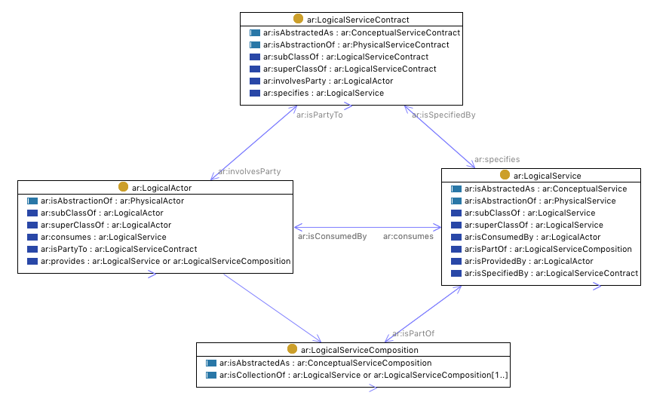
Architectural “Meta Classes” Logical Level
ar:isProvidedBy ar:provides
ar:provides
© 2000-2017 Smart Electric Power Alliance. All Rights Reserved. Page 28
Notes:
The Meta Classes have defined relationships.

Slide 29
Architectural “Meta Classes”
Conceptual Service Contract
Xxxxx xxxxx
Xxxx xxxx
xxxx xxxxxx xxx
Conceptual Service
Xxxxx xxxxx
Xxxx xxxx
xxxx xxxxxx xxx
xx xxxxx xxxxxxx
Conceptual Service Composition
Xxxxx xxxxx
Xxxx xxxx
Logical Service Contract
Xxxxx xxxxx
Xxxx xxxx
xxxx xxxxxx xxx
xx xxxxx xxxxxxx
Logical Actor
Xxxxx xxxxx
Xxxx xxxx
xxxx xxxxxx xxx
xx xxxxx xxxxxxx
Logical Service
Xxxxx xxxxx
Xxxx xxxx
xxxx xxxxxx xxx
xx xxxxx xxxxxxx
Logical Service Composition
Xxxxx xxxxx
Xxxx xxxx
xxxx xxxxxx xxx
xx xxxxx xxxxxxx
Physical Service Contract
Xxxxx xxxxx
Xxxx xxxx
xxxx xxxxxx xxx
xx xxxxx xxxxxxx
Physical Actor
Xxxxx xxxxx
Xxxx xxxx
xxxx xxxxxx xxx
xx xxxxx xxxxxxx
Physical Service
Xxxxx xxxxx
Xxxx xxxx
xxxx xxxxxx xxx
xx xxxxx xxxxxxx
© 2000-2017 Smart Electric Power Alliance. All Rights Reserved. Page 29
Notes:
The Meta Classes are organized into three levels of abstraction: Conceptual, Logical and Physical

Slide 30
Abstraction Levels Applied to SOA
Work-in-progress
2016 Copyright © SGIP, Inc. CONFIDENTIAL. ALL RIGHTS RESERVED Page 30
© 2000-2017 Smart Electric Power Alliance. All Rights Reserved. Page 30

Slide 31
Cooling Example
2016 Copyright © SGIP, Inc. CONFIDENTIAL. ALL RIGHTS RESERVED Page 31
© 2000-2017 Smart Electric Power Alliance. All Rights Reserved. Page 31

Slide 32
Categorization Guidelines for Architectural Elements
Categorize the original elements
Identify elements as Actors, Services, ServiceCompositions, and ServiceContracts
Identify the Architecture Abstraction Levels
Conceptual - these are the business-to-business (B2B) relationships, the B2C (consumer), and the B2R (regulatory & policy). Thus a black-box view of the business.
Logical – this is where Actors come in, but there are also Services. This is a white-box view of the business, showing the internal elements and their relationships.
Physical - the representation of a Specification, where the required features (functional and non-functional) are included. Technology approaches are chosen.
Implementation – actual technology product choices and implementation configuration decisions are made.
© 2000-2017 Smart Electric Power Alliance. All Rights Reserved. Page 32

Slide 33
Categorization Guidelines for the Elements
Semantics should be explicitly documented to reduce ambiguity
An Actor is considered to be a person, organization, or system that has at least one role (ServiceComposition) that initiates or interacts with other Actors. Actors may be internal or external to an organization
A ServiceComposition is the usual or expected function, or context, in which an actor consumes/provides a service. An Actor may play a number of roles
At the highest level, a Conceptual ServiceComposition represents the goals of the stakeholder (e.g.: Energy Provider). A Conceptual ServiceComposition will have many defining characteristics
A Logical ServiceComposition decomposes/partitions a conceptual role into functional components. At the Logical level is where the mapping from roles to Actors occurs
There is no such thing as a Physical ServiceComposition. At this level an Actor simply offers services according to advertised interfaces. Similarly, there is no such thing as a Conceptual Actor
A Conceptual ServiceComposition maps to one or more Logical Service Compositions, which get related to one or more Logical Services which are consumed or provided by Logical Actors
A Physical Actor is an instantiation of a Logical Actor. A Physical Actor performs a set of actions which is a Physical instantiation of a Logical ServiceComposition
2016 Copyright © SGIP, Inc. CONFIDENTIAL. ALL RIGHTS RESERVED Page 33
© 2000-2017 Smart Electric Power Alliance. All Rights Reserved. Page 33

Slide 34
Summary
Created an OWL model (SOA focused), that shows the relationships of the elements across the Conceptual, Logical, Physical abstraction levels
Started work on:
using a specific real world use case set of Actors, Services, messages to vet out the OWL model;
relating the use case set of elements to the gathered set of elements using a “neutral concepts” OWL model of the business scenario that the use case came from;
Intent is to create the appropriate relationships of one set of elements to another for the purposes of helping identify a common vocabulary of architectural/business terms and elements.
2016 Copyright © SGIP, Inc. CONFIDENTIAL. ALL RIGHTS RESERVED Page 34
© 2000-2017 Smart Electric Power Alliance. All Rights Reserved. Page 34

Slide 35
NEUTRAL CONCEPTS MODEL APPROACH

Slide 36
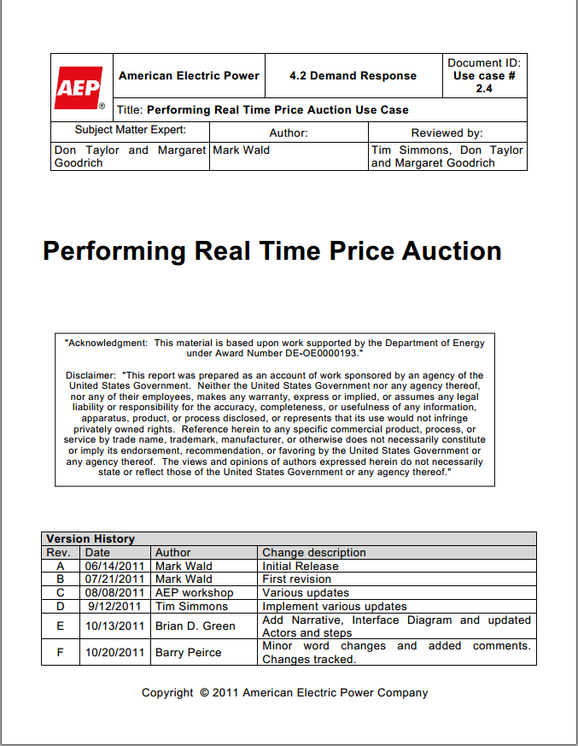
Mapping Use Case Terms
(example from EPRI IntelliGrid Use Case Repository)
Let’s look at this term
© 2000-2017 Smart Electric Power Alliance. All Rights Reserved. Page 36
Notes:
To illustrate how the categorization works in a use case, let’s consider a use case example from AEP “AEP Performing Real Time Price Auction”, located in EPRI’s Use Case Repository http://smartgrid.epri.com/Repository/Repository.aspx. In particular, let’s focus on the term called HEM, for Home Energy Manager.

Slide 37
The HEM in the AEP/EPRI use case
HEM stands for “Home Energy Management” (System)”
What does that really mean?
Home Energy Management System
=
A piece of hardware and/or software
(an Actor)
…that performs a set of Services
© 2000-2017 Smart Electric Power Alliance. All Rights Reserved. Page 37
Notes:
We can tease apart the words “Home Energy Management System” to suggest that it is an Actor that provides a set of Services

Slide 38
The HEM in the AEP/EPRI use case
A piece of hardware and/or software
(an Actor)
There are different kinds of hardware.
What kind of hardware?
There are different grades of hardware.
Sensor hardware
Industrial grade
Actuator hardware
Commercial grade
Control hardware
Residential grade
2016 Copyright © SGIP, Inc. CONFIDENTIAL. ALL RIGHTS RESERVED Page 38
© 2000-2017 Smart Electric Power Alliance. All Rights Reserved. Page 38
Notes:
Since the collected terms may not cover all possible kinds of Actors, a Neutral Model is helpful to cover all possibilities. For example, you could classify different subclasses of hardware, such as Sensor hardware, Actuator hardware, Control hardware, etc. Similarly, it might be useful to partition hardware by quality grade.

Slide 39
The HEM in the AEP/EPRI use case
Logical hardware
Logical Sensor hardware
Logical Control hardware
Logical Actuator hardware
Industrial grade
satisfies
Commercial grade
HEM
satisfies
Residential grade
= subClass
= relationship
© 2000-2017 Smart Electric Power Alliance. All Rights Reserved. Page 39
Notes:
The HEM can be classified under both of these (and other) schemes as shown here. The implication of the “satisfies” relation is that it meets all the specifications defined for the relevant classifications.

Slide 40
The HEM in the AEP/EPRI use case
OK, we have characterized the hardware.
What about the Services it performs?
Home Energy Management System
=
A piece of hardware and/or software
(an Actor)
…that performs a set of Services
2016 Copyright © SGIP, Inc. CONFIDENTIAL. ALL RIGHTS RESERVED Page 40
© 2000-2017 Smart Electric Power Alliance. All Rights Reserved. Page 40
Notes:
Next, we can examine the kinds of services provided.

Slide 41
The HEM in the AEP/EPRI use case
LogicalServiceComposition
Services
We can define a hierarchy of Services
For this Demand Response (DR) use case, we know the HEM provides at least a DR service
FacilityService
DistributionService
EnergyManagementService
SecurityService
HVACManagementService
DRVENService
DERManagementService
= subClass
HEM
= relationship
© 2000-2017 Smart Electric Power Alliance. All Rights Reserved. Page 41
Notes:
Again, the Neutral Model can give the context for classifying services.

Slide 42
The HEM in the AEP/EPRI use case
Definition of HEM
So, a definition of the HEM in this use case might be captured as follows:
Logical Control hardware
satisfies
LogicalActor
type
HEM
satisfies
Residential grade hardware
provides
DRVENService
© 2000-2017 Smart Electric Power Alliance. All Rights Reserved. Page 42
Notes:
We end up with this partial characterization for HEM, which is captured in a computer-sensible form that can be used for reasoning.
DR: demand response
VEN: virtual end node, from OpenADR

Slide 43
“BuildingManagementSystem”
Definition from the EU
A system consisting of several decentralized controllers and a centralized management system to monitor and control the heating, ventilation, air conditioning, light and other facilities within a building.
Commercial grade hardware
satisfies
LogicalActor
type
BuildingManagmentSystem-89
satisfies
provides
provides
Logical Control hardware
LightingManagementService
HVACManagementService
isCollectionOf
isCollectionOf
isCollectionOf
HeatingControlService
VentilationControlService
ACControlService
© 2000-2017 Smart Electric Power Alliance. All Rights Reserved. Page 43
Notes:
Let’s look at some other terms in our collection. From the description of BuildingManagementSystem-89, we can establish the associations to a Neutral Model as shown.
HVAC is heating, ventilating, and air conditioning
ACControlService is air conditioning control service

Slide 44
“BuildingManagementSystem”
How does this help? Because if you want to interface with something that provides HVACManagementService, then you are guaranteed that it can perform HeatingControlService (for example).
Commercial grade hardware
satisfies
LogicalActor
type
BuildingManagmentSystem-89
satisfies
provides
provides
Logical Control hardware
LightingManagementService
HVACManagementService
isCollectionOf
isCollectionOf
isCollectionOf
HeatingControlService
VentilationControlService
ACControlService
© 2000-2017 Smart Electric Power Alliance. All Rights Reserved. Page 44
Notes:
How does this help? Because if you want to interface with something that provides HVACManagementService, then you are guaranteed that it can perform HeatingControlService (for example).

Slide 45
“BuildingAutomationSystem”
…and we can infer that BuildingAutomationSystem-86 can do everything BuildingManagementSystem-89 can do because of the skos:narrower relation.
Actor (from NISTIR 7628)
BuildingAutomationSystem-86
type
narrower
Commercial grade hardware
LogicalActor
satisfies
type
BuildingManagmentSystem-89
satisfies
Actor (from TC8 WG6)
provides
provides
Logical Control hardware
LightingManagementService
HVACManagementService
isCollectionOf
isCollectionOf
isCollectionOf
HeatingControlService
VentilationControlService
ACControlService
© 2000-2017 Smart Electric Power Alliance. All Rights Reserved. Page 45
Notes:
…and we can infer that BuildingAutomationSystem-86 can do everything BuildingManagementSystem-89 can do because of the skos:narrower relation. This is because BuildingAutomationSystem-86 is declared to be a special case of BuildingManagementSystem-89 …. a system that is also automated.

Slide 46
Implications
Because all this information is represented formally in a semantic language (OWL), it is possible to perform logical reasoning on it. Therefore, if we correctly categorize systems and services, we can begin to automatically identify where interoperability is possible, and where there will be problems.
Vendor A
(provides LightingManagement and HeatingControl, and may not meet residential requirements)
Residential grade hardware
Logical Control hardware
satisfies
satisfies
Vendor B
(provides HVACManagement, not lighting, and may not meet commercial requirements)
LogicalActor
type
Vendor B Hardware
Commercial grade hardware
Logical Control hardware
provides
satisfies
satisfies
LightingManagementService
HVACManagementService
LogicalActor
type
Vendor A Hardware
isCollectionOf
isCollectionOf
provides
isCollectionOf
HVACManagementService
ACControlService
LightingManagementService
provides
VentilationControlService
isCollectionOf
isCollectionOf
isCollectionOf
HeatingControlService
HeatingControlService
VentilationControlService
ACControlService
© 2000-2017 Smart Electric Power Alliance. All Rights Reserved. Page 46

Slide 47
POTENTIAL FUTURE PHASE

Slide 48
Potential Future Phase
Add relationships between concepts based on latest tool capabilities
Populate and expand Neutral Concepts model
Expand interoperability between modeling tools
© 2000-2017 Smart Electric Power Alliance. All Rights Reserved. Page 48

Slide 49
Future Phase - Details
Adding Relationships
Serves to validate and clarify the initial categorizations
Reveals ambiguities, missing concepts, distinctions between terms. This is a key effort in the next phase.
Ties together concepts originating from different domains (as in the BuildingAutomationSystems example)
Formalizes the terms in a computable manner
© 2000-2017 Smart Electric Power Alliance. All Rights Reserved. Page 49

Slide 50
Future Phase - Details
Populating the Neutral Concepts Model
Provides the concepts that didn’t happen to show up in the contributed terms/vocabularies (as in the HEM example)
Provides abstractions (superclasses) that tie together terms
Provides context for contributed terms
© 2000-2017 Smart Electric Power Alliance. All Rights Reserved. Page 50

Slide 51
Future Phase - Details
Interoperability: TBC OWL to Sparx EA's including support for ArchiMate 3.0
SGAC modelers have started on mapping Architectural Elements between SOA and ArchiMate 2.1 – DRAFT r0.6
A plan for data sharing between tools
© 2000-2017 Smart Electric Power Alliance. All Rights Reserved. Page 51
Notes:
Mappings from https://members.sgip.org/kws/groups/sgip-sgac-awp/documents/working309/document?document_id=9836

Slide 52
Mapping: Architectural Elements between SOA and ArchiMate 2.1 – DRAFT r0.6 table row set 1
Work-in-progress
© 2000-2017 Smart Electric Power Alliance. All Rights Reserved. Page 52
Notes:
This comparison was done between SOA r2 with ArchiMate 2.1. Need to vet this mapping with ArchiMate 3.0 for what has changed that might address some of the raised points.

Slide 53
Mapping: Architectural Elements between SOA and ArchiMate 2.1 – DRAFT r0.6 table row set 2
Work-in-progress
© 2000-2017 Smart Electric Power Alliance. All Rights Reserved. Page 53

Slide 54
Mapping: Architectural Elements between SOA and ArchiMate 2.1 – DRAFT r0.6 table row set 3
Work-in-progress
© 2000-2017 Smart Electric Power Alliance. All Rights Reserved. Page 54

Slide 55
Mapping: Architectural Elements between SOA and ArchiMate 2.1 – DRAFT r0.6 table row set 4
Work-in-progress
© 2000-2017 Smart Electric Power Alliance. All Rights Reserved. Page 55
Notes:
Conceptual level models the actual business as the Owner conceptually thinks the business is or maybe, wants the business to be. Treat the business as “black box” noting the major functions & capabilities that business has with customers and other 3rd parties Some users of ArchiMate have: conceptual abstraction elements positioned in the Business layer; logical abstraction elements positioned in the Application layer; physical abstraction elements in the Technology layer. Some also equate the Business layer to Conceptual.
EA can absolutely mix UML class diagrams to behavior diagrams. When some diagramming concepts are complementary: draw a business process, then decompose into an activity diagram and/or sequence diagrams. How does ArchiMate support this: doesn’t care, not using it to generate other artifacts. E.G.: business layer’s inactive objects (meter reading), application layer (map to CIM UML class diagram for the application layer data objects), then technology layer (map the technology data object to DDL - database definition language). Different UML diagrams complement the ArchiMate diagrams. Informational links, hyperlinks, drag&drop to create a hyperlink to so the diagrams are related.
[note that the ArchiMate architecture diagrams services are associated with interfaces, components, functions, and objects (where information is stored/passed). ArchiMate 2.1 metamodel does not explicitly support the associations or linkages across the conceptual, logical, physical abstraction levels as ADWP illustrates in the SOA Visio illustration. ArchiMate does support relationships from e.g. business service to an application service via derived relationships.]
Logical level models of the “systems” of the Business, and treats the business as “white box” to further detail and describe the functions & capabilities performed within the business and with 3rd parties. How the Architecture is (ideally) structured?
Physical level models the technology-constrained, physical implementation design of the systems of the business.
Documents the Building block specifications, requirements, descriptions, non-functionals.

Slide 56
Tools: Exchange Experiments
CSV (works)
Very picky with spaces and allowed characters
Archi
Excel
CSV (works)
CSV (somebody who really knows
EA could probably program this)
CSV (works for categorization,
relationships would require
programming)
CSV (works)
CSV (works)
TBC
EA
XML (would take a lot
of programming)
Using a specialized script on XML
(partially worked – entities, not relations.
Would take some programming)
© 2000-2017 Smart Electric Power Alliance. All Rights Reserved. Page 56
Notes:
ArchiMate – is a specification by The OpenGroup. Several vendors have built tools that provide varing degrees of conformance to a specific ArchiMate spec release.
ArchiMate tools tested included: a) Archi, b) Sparx EA including tool support for ArchiMate
The modeling tools being used by ADWP includes: Top Quadrant’s TopBraideComposer – Maestro edition, Sparx EA, spreadsheets e.g. Microsoft’s Excel

Slide 57
Tools: Archi v3.x Export Format
ID | Type | Name
5544b54c | ArchimateModel | (new model)
b5995997 | BusinessActor | Business Actor 3
fef227a6 | BusinessActor | CustomerAppliance
d89934c8 | BusinessFunction | Business Function
59de4964 | BusinessRole | Business Role
8066cb08 | BusinessRole | Business Role 2
9cdbbc83 | BusinessService | ApplianceControl
ff57a9b5 | ApplicationService | Application Service
8ff1067d | InfrastructureService | Infrastructure Service
d5d8a675 | Junction | Junction
© 2000-2017 Smart Electric Power Alliance. All Rights Reserved. Page 57

Slide 58
Tools: Archi Import Format
ID | Type | Name | Documentation
1 | BusinessRole | EnergyDispatcher | Actor Role in charge of dispatching Electricity usually at the transmission level
2 | ApplicationComponent | Access Point ie. Data Aggregation Point | Collects and aggregates all data fromto end devices through Neighbourhood andor Field Area andor AMI networks. These devices are IEEE 802.11n compliant. They interface the Backhaul WAN.
3 | BusinessService | Account Management | Business function or service that manages supplier and customer business accounts.
4 | ApplicationComponent | Account Management System | Business function or service that manages supplier and customer business accounts.
5 | BusinessRole | Actuator | An actuator is a transducer that accepts a signal and converts it to a physical action. In other words
7 | BusinessRole | Aggregator | The role that combines curtailment
8 | ApplicationComponent | AMI Head-end | Provides the Interface to the Advanced Metering Infrastructure and manages the information exchanges between third party systems. The head-end is the command application for AMI solution. Optionally it manages required or desired meter reading schedules
9 | ApplicationComponent | AMI Operator | General operator of the AMI system
10 | ApplicationComponent | AMI Service Engineer | External actor responsible for the installation
© 2000-2017 Smart Electric Power Alliance. All Rights Reserved. Page 58

Slide 59
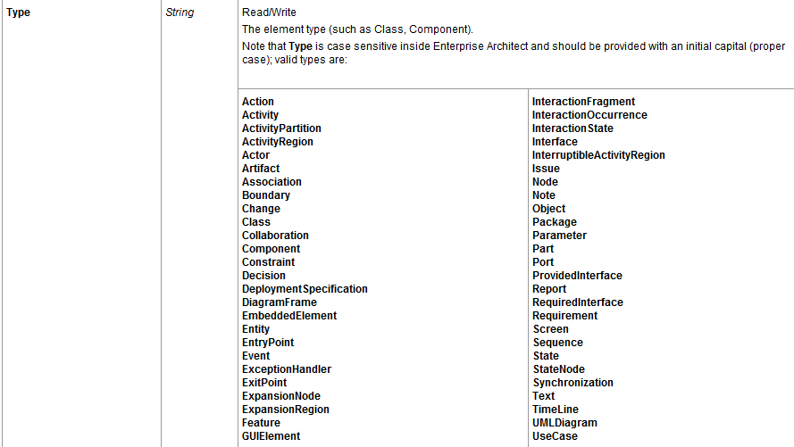
Tools: Valid Sparx EA 12.1 Import Types
© 2000-2017 Smart Electric Power Alliance. All Rights Reserved. Page 59

Slide 60
Tools: TBC Format (sample subset)
Entity Name | Description | Abstraction Level | Element Type | skos | NAESB | CSWG NISTIR 7628 | CSWG Actors | IEEE P2030 Draft 3 | EIS | EU Commission | EU WGSP Vers 0-5 | SGAC Conceptual Arch
Aggregator | offers services to aggregate energy production from different sources (generators) and acts towards the grid as one entity, including local aggregation of demand (Demand Response management) and supply (generation management). In cases where the aggregator is not a supplier, it maintains a contract with the supplier. | Conceptual | ServiceComposition | TBD
AMI Operations | General operator of the AMI system | Logical | Actor | TBD |  |  |  |  |  |  | X
AMI Service | ServiceComposition responsible for the installation, operation, maintenance and de-installation of the system components. It may access, if properly identified and authorized, those components either directly, via local operation and maintenance interfaces, or from a system component from a higher hierarchical level (e.g. meters may be accessed for maintenance purposes via NNAPs or the HES). | Logical | ServiceComposition | TBD |  |  |  |  |  |  | X
The Entity Name and Description were key to determining the abstraction level and element type. The submitting organization’s identity was imported for traceability.
© 2000-2017 Smart Electric Power Alliance. All Rights Reserved. Page 60
Notes:
This is a small sample of the Excel spreadsheet that contains the data from the 18 submitting organizations, showing Entity Name, Description, and submitting organization. The ADWP modelers added the Abstraction Level, and Element Type as described in this slide deck. The skos field would show the relationship to ADWP Neutral Concepts Model, as planned but TBD.

Slide 61
Thank you

